Slide 1
creek indians

Slide 2
regions
The Creek Indians lived in the northern part of
Georgia and Alabama. There were several tribes
who lived under the Creek Indian name. One of
these tribes was called the Muskogee Tribe.
This name should sound familiar. We live in
Muscogee County.
The Creek Indians received their name
because many of their villages were built by a
creek.
A creek is a small stream of water.

Slide 3
regions
The Creek Indians were located across 4
states: Oklahoma, Georgia, Alabama and
Florida.
Today, most of the Creek Nation lives in
Oklahoma.

Slide 4
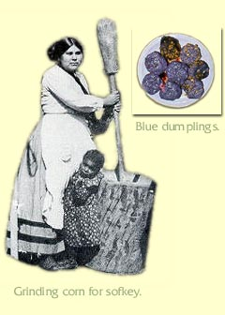
families
The men hunted deer while
women gather nuts, wild onions
and berries. They tended
gardens full of corn, beans
and squash and shared
food with all. Corn was
important food and women
ground it into meal and made
"sofkey“ and blue dumplings.

Slide 5
families
Creek women and girls were
responsible for farming and raising
children.
Creek men and boys were
responsible for building homes,
hunting and fishing. After many
hunts, men would use the bones and
rocks to make tools.

Slide 6
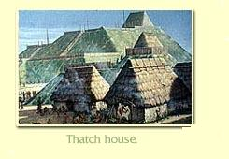
creek villages
A typical village was
built around the council
house and a large field
used for sports.
The houses had
thatched roofs. Thatch
is dried grass layered to
make the walls and
roofs.

Slide 7
creek villages
Depending on the wealth of the Creek family,
a family may have had up to 4 buildings. Each
building served a different purpose for the family.
The walls of these dwellings were made from
mud and straw. The roofs were made from
cypress bark.
Near each dwelling, the women and girls would
plant a small garden. Outside the village, each
member of the village participated in the farming
of a much larger garden.

Slide 8
clothing
Women and girls made the clothing for the
family. They used animals skins to make
their clothing and bones, feathers and
beads to decorate their clothing.
Different clothing was made for different
occasions. Creek Indians had different
clothing for special ceremonies, war, and
everyday use.

Slide 9
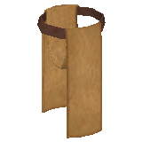
clothing
In summer, the Creek
Indians wore few
clothes. Men wore deerskin
breechcloths and women
wore skirts. Children
usually did not wear
clothes.
Breechcloth

Slide 10
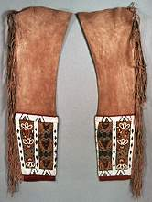
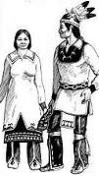
clothing
During the winter
months, the Creek Indians
wore heavy clothes
to protect them from the
cold weather.
Women wore long
dresses with leggings
underneath them.
Deer Skin Leggings

Slide 11
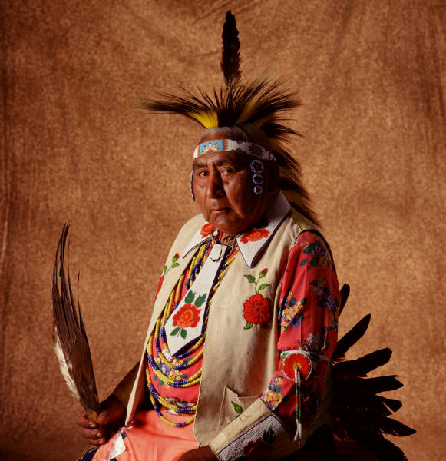
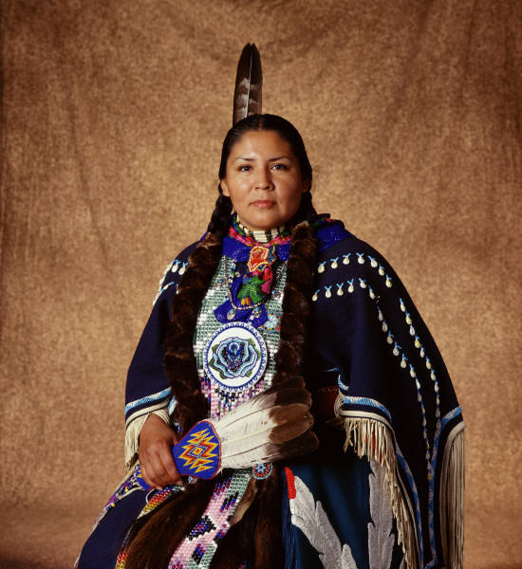
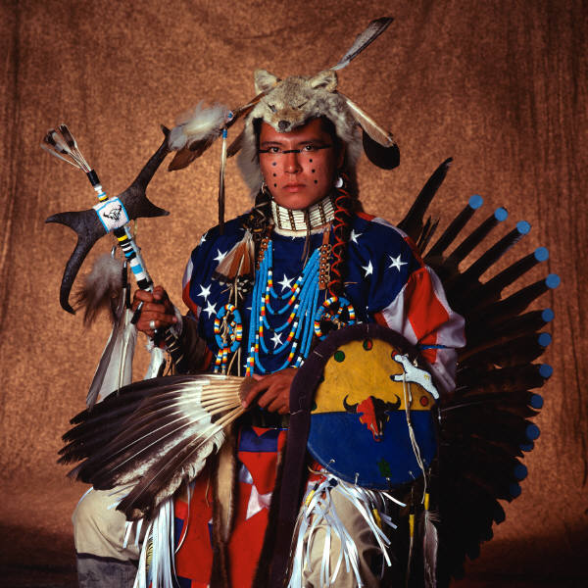
clothing

Slide 12
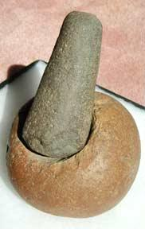
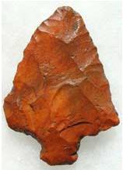
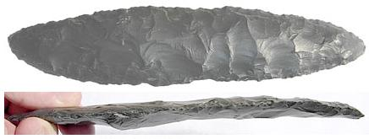
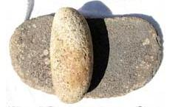
accomplishments
The Creek Indians had to use
what resources were available
to them in the forest and
around the creeks. The Creek
Indians made tools from stone
and wood. What do you think
these items were used for by
the Creek Indians?
arrow head
grinding stone
knife
rolling pen

Slide 13
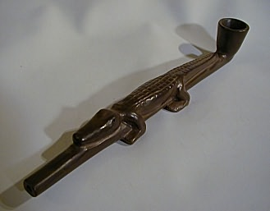
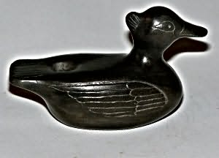
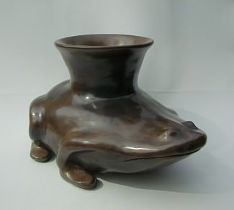
accomplishments
The Creek Indians also had a
language the used to communicate
within the tribe. The Creek alphabet
is made up of 20 letters.
Art was also a big part of the
Creek’s culture. Pottery influenced
the function of everyday life of the
Creek Indians. Art was profoundly
used in the construction of Creek
pottery.
Pipe

