Slide 1
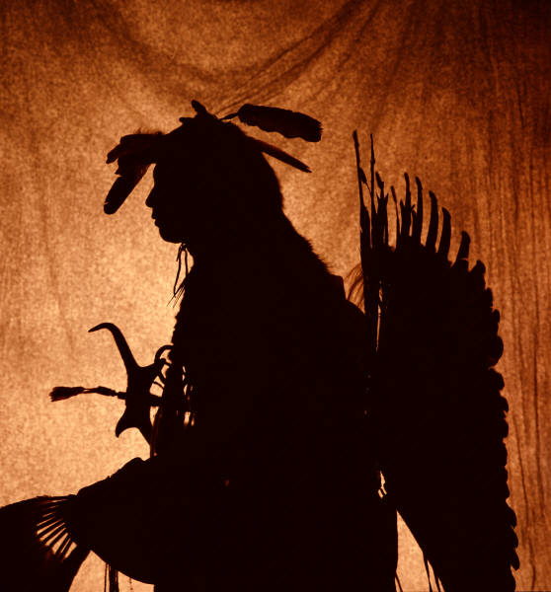
Cherokee Indians

Slide 2
The Cherokee Indians
The Cherokee name actually came from
the Creek name “Chelokee”. This means
“People of a different speech.”
The Cherokee Indians where located in
both states of Alabama and Georgia.

Slide 3
Villages & Homes
They lived in about 200 fairly large villages. A
normal Cherokee village had about 30 - 60
houses and a large meeting building. Cherokee
homes were usually wattle and daub. Wattle is
twigs, branches, and stalks woven together to
make a frame for a building. Daub is a sticky
substance like mud or clay.

Slide 4
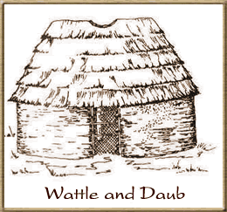
Homes
The Cherokee covered the
wattle frame with daub. This
created the look of an upside
down basket. The Cherokee
villages also had fences around
them to prevent enemies from
entering.
There was a summer village
and a winter village.

Slide 5
Winter Homes
Each family had two homes. These homes were
located in the two different villages, the summer
village and the winter village.
Winter Round Homes: Round homes were made of
wood, and covered with mud for additional
protection against the cold. Homes had bark
roofs. The homes were decorated with colorful
rugs, baskets, and wall hangings. Each home had a
fire burning in the center. Homes had smoke
holes at the top to let out the smoke.

Slide 6
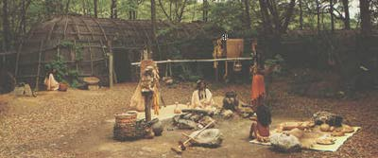
Summer Homes
Summer Rectangle Homes:
Summer homes were bigger. They were made in the shape
of huge rectangles. Cone shaped roofs were made of
bark, covered with long grass. The house was made with
long sticks. These homes were cool and airy, and let in
light.

Slide 7
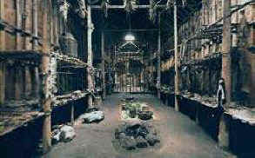
Summer Homes
In the summer homes, many members of
the same family would live in the same
house. Fires would be down the middle of
the house for cooking

Slide 8
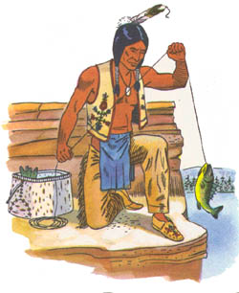
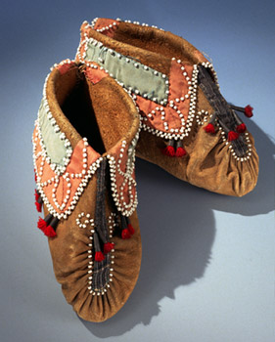
Clothing
Clothing varied throughout
the year. Lighter clothes were
worn during the warm months,
while more and heavier clothes
were worn during the cold
months. Clothing was made of
woven cloth or soft deer skin.
Women wore dresses. The men
wore pants. Everyone wore
moccasins.

Slide 9
Role of the Family: Men
Both men and women were treated equal.
Men cut down trees to clear land for
planting. They used the wood to build
canoes, homes, and the pole fences around
the villages. They hunted and fished. They
made traps, nets, and other tools.

Slide 10
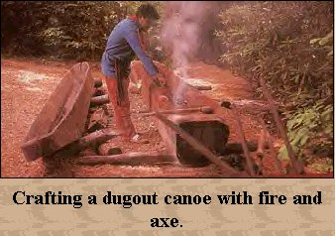
Canoes
Canoes were carved from wood. The men
first cut a log. They hollowed out the log
by using burning coals from the fire. They
scraped the insides
with sharp stones.
Canoes were
decorated with
designs made with
burnt sticks
and sharp stones.

Slide 11
Role of the Family: Women
The role of Cherokee women in the past
was very different than the role of other
American women. In the Cherokee Nation,
women were warriors. Women ruled the
home. Although the men built the homes,
the women owned them. Women had
power over their families, participated in
government, and fought as warriors.

Slide 12
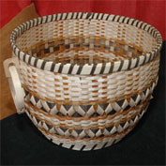
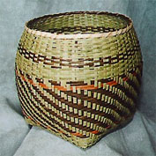
Role of the Family: Women
They also did the same jobs as did
other Indian women. They were very
proud of their colorfully designed
baskets. Baskets were used to gather
nuts in the fall, and store goods. The
women were the farmers. They planted
seed and harvested crops. They stored
food. Young girls pounded corn into
flour. Women used the skins of
animals to make clothing and other
goods. They also raised the children.

